Slide 1
The Tilt TUne Project
Using Intel Edison

Slide 2
PROJECT Members
Ingrid Wu
Yung
John Sung

Slide 3
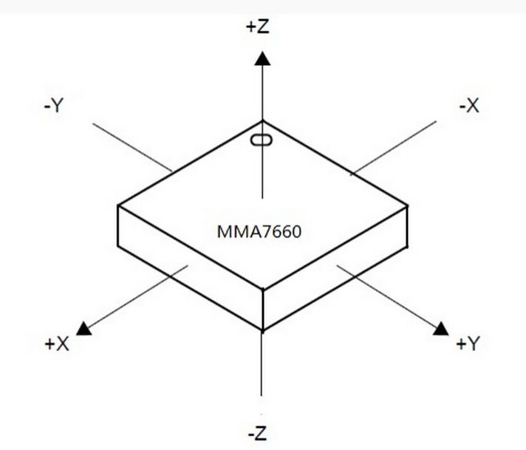
Sensors
Grove - 3-Axis Digital Accelerometer(±1.5g)

Slide 4
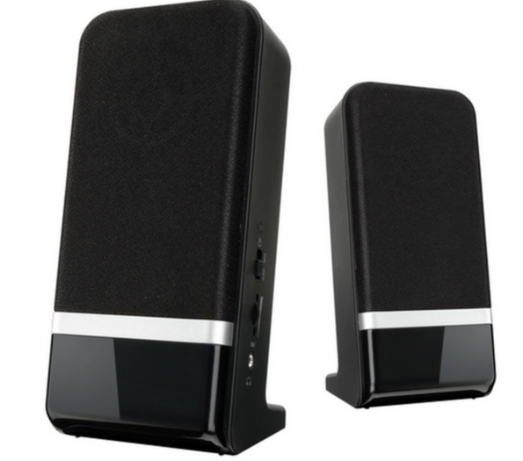
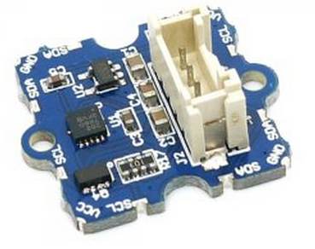
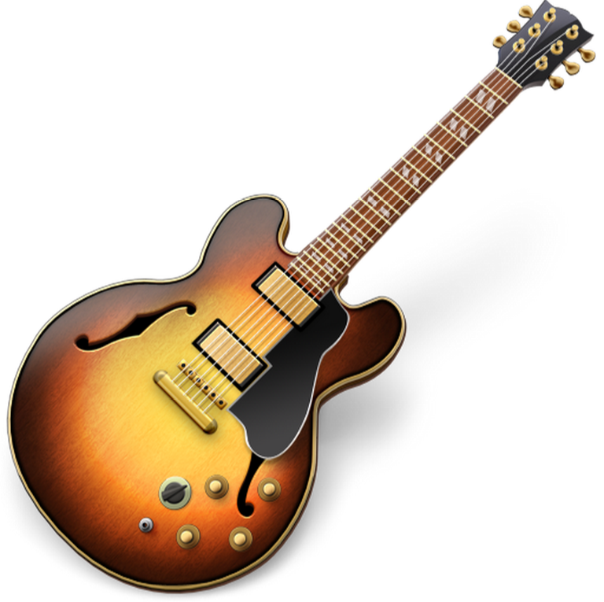
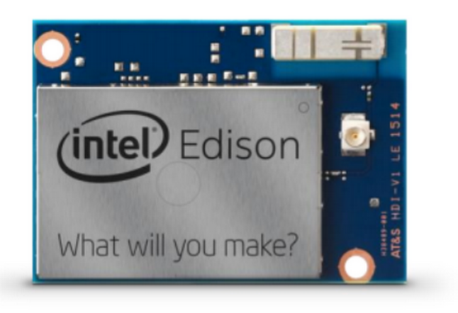
Connections
3-Axis Digital Accelerometer
Mac
IAC
( Inter-application communication) Driver
Serial Port
Hairless MIDI <-> Serial Bridge
Garageband

Slide 5
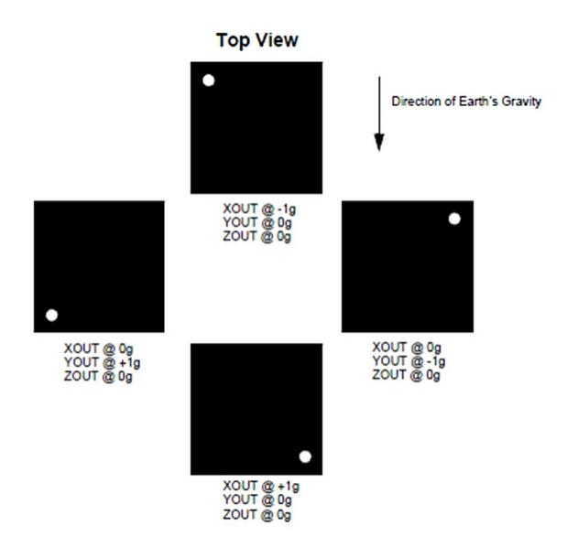
Using the 3-Axis Digital Accelerometer X AXIS : Mapping LOADNESS
ON: Largest Volume
-0.5
ON: Larger Volume
0.3
ON: Smaller Volume
0.9
OFF

Slide 6
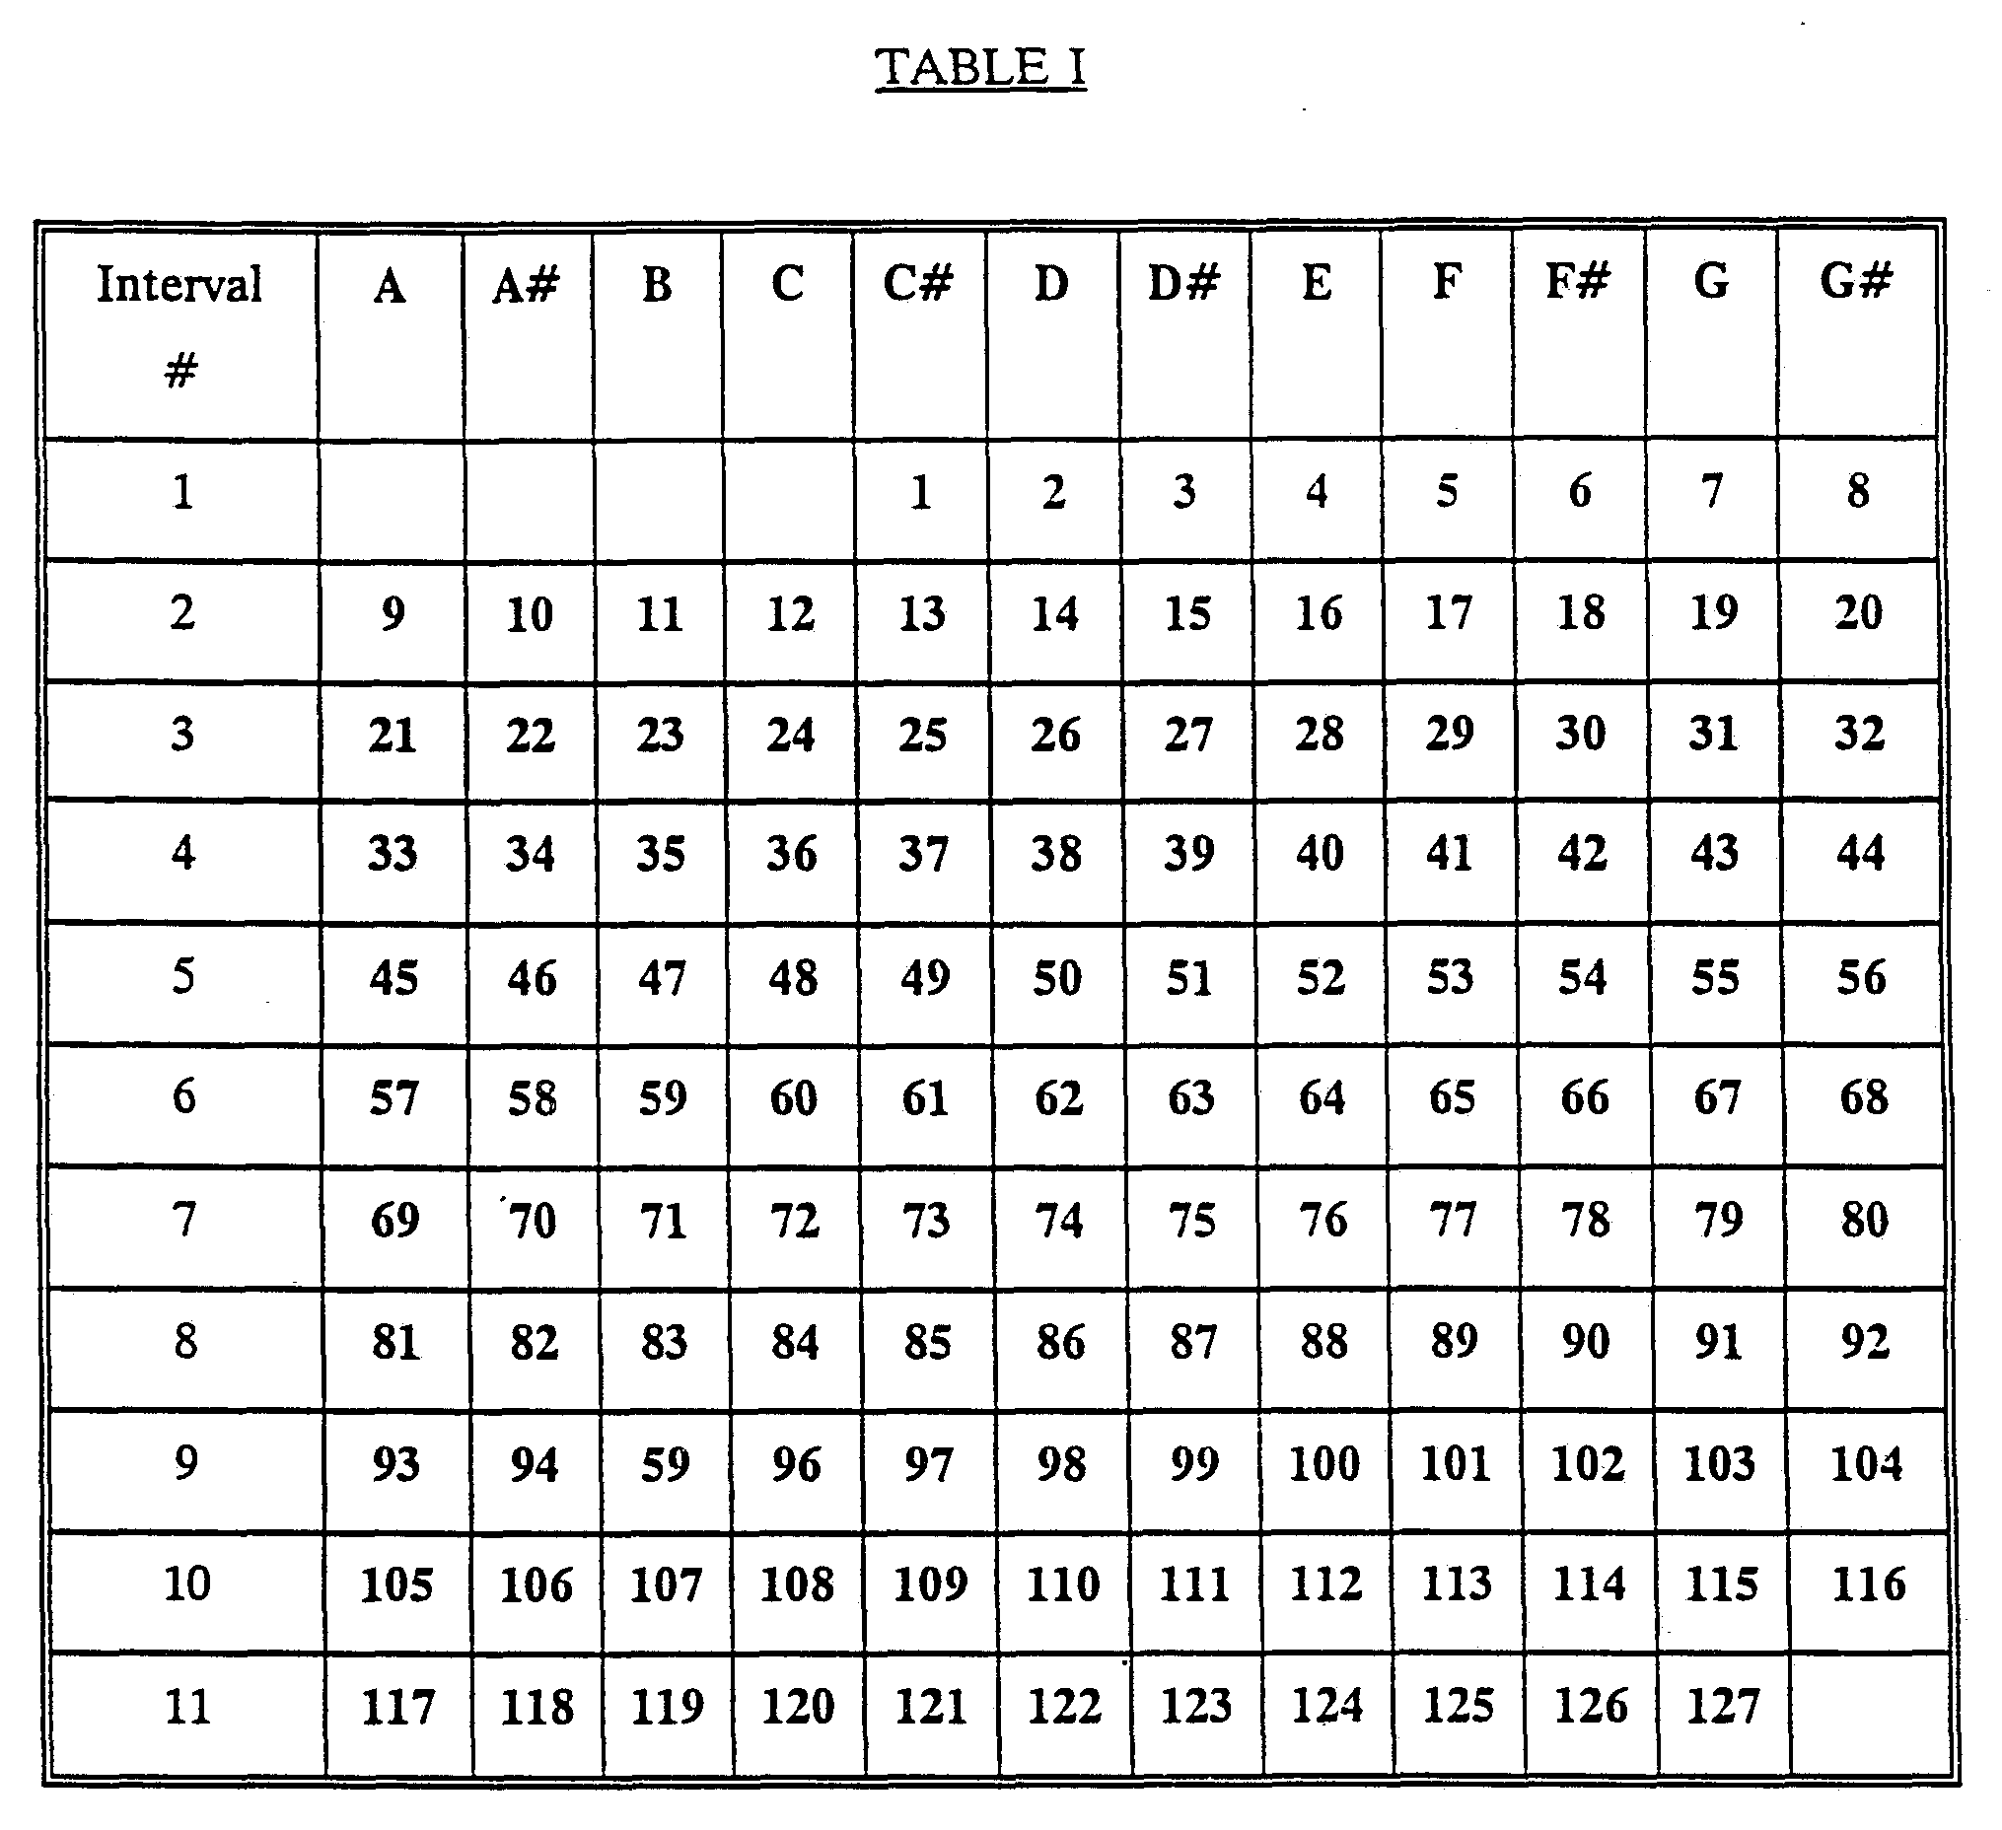
Using the 3-Axis Digital Accelerometer Y AXIS : mapping PITCH
C
D
E
F
G
A
B

Slide 7
Thank You !

